Slide 1
FSWD ii ASSIGNMENT-1
SUBMITTED TO – KULANSHU SIR
SUBMIT BY – DIVYA [22105012]
TOPIC – NODE JS

Slide 2
CONTENT
WHAT IS NODE JS
INTRODUCTION
NODE JS ARCHITECTURE
FEATURES
SINGLE THREADED
EVENT DRIVEN
HOW NODE JS IS ASYNCHRONOUS

Slide 3

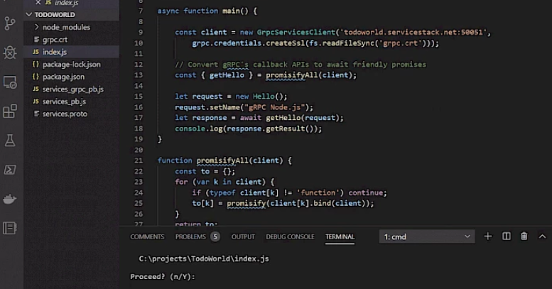

Slide 4
INTRODUCTION
Definition: Node.js is an open-source, cross-platform JavaScript runtime environment that executes JavaScript code outside of a web browser.
Built On: It uses the V8 JavaScript engine developed by Google for Chrome, which compiles JavaScript to machine code for faster execution.

Slide 5
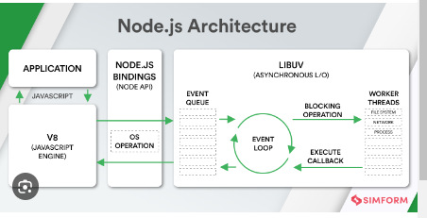
NODE JS ARCHITECTURE

Slide 6
FEATURES
Asynchronous and Event-Driven: Node.js handles multiple operations concurrently without blocking the execution of code. This makes it highly efficient for I/O-intensive tasks.
Non-Blocking I/O: It processes requests asynchronously, allowing applications to handle numerous tasks simultaneously, improving performance and scalability.
Single Programming Language: Developers can write both client-side and server-side code in JavaScript, streamlining development and enhancing productivity.
npm (Node Package Manager): Comes with npm, a rich ecosystem of libraries and modules, making it easy to add functionality and manage dependencies.

Slide 7
EVENT DRIVEN FEATURE
Core Mechanism: Node.js uses an event loop to continuously check for and handle events. It processes these events by executing their associated callbacks.
Non-Blocking: While waiting for tasks like file reads or network requests to complete, Node.js continues running other code without waiting.

Slide 8
SINGLE THREADED
Single Threaded Event Loop: Node.js operates on a single main thread that handles the execution of code, including managing the event loop.
JavaScript Execution: All JavaScript code in Node.js runs on this single thread, which simplifies development and avoids issues related to multi-threading, such as race conditions.

Slide 9
HOW NODE JS IS ASYNCHRONOUS
Asynchronous programming allows tasks to be executed independently of the main thread. This means the system can continue performing other tasks while waiting for long-running operations (like file reads or network requests) to complete.
handle tasks in a non-blocking manner, which allows it to perform multiple operations simultaneously without waiting for each one to complete before starting the next.

Slide 10
HOW ALL THREE WORKS TOGETHER
INCOMING REQUEST- A client sends a request to a node js server .
EVENT LOOP- The event loop receives the request and adds it to the event queue.
Asynchronous operation – If the request involves an asynchronous operation [ like reading a file from the desk], node js delegates the operation to the operating system and continues processing other events in the event loop .
Callback queue : when the asynchronous operation completes, its callback function added to the callback queue.
Event loop processing – the event loop eventually processes the callback queue and execute the callback function . The callback function can then handle the result of the asynchronous operation and send the response to client.

